Slide 1
Topic 30:
Communicating Information
30.1 Principles of Modulation
30.2 Sidebands and bandwidth
30.3 Transmission of information by digital means
30.4 Different channels of communication
30.5 The mobile-phone network

Slide 2
30.4: Channels of Communication
Wire-pairs
Coaxial cables
Radio waves
Microwaves
Optic fibres

Slide 3
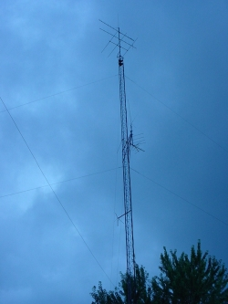
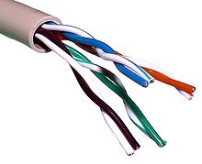
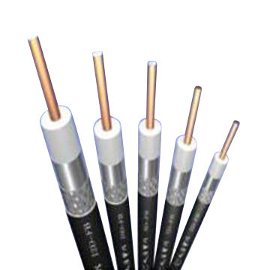
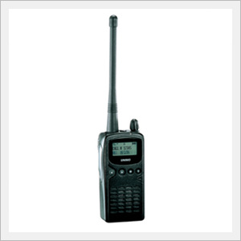
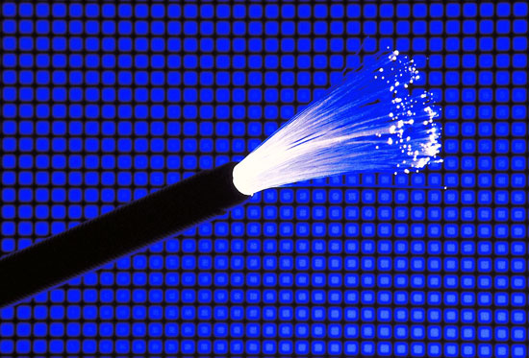
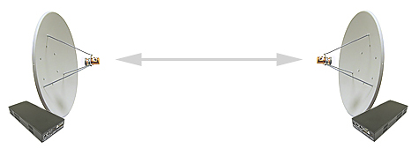
Channels of Communication
Channels of communication are the different means/media of transferring signals.
Wire-pairs
Radio Link
Microwave Link
Coaxial Cables
Optic Fibres

Slide 4
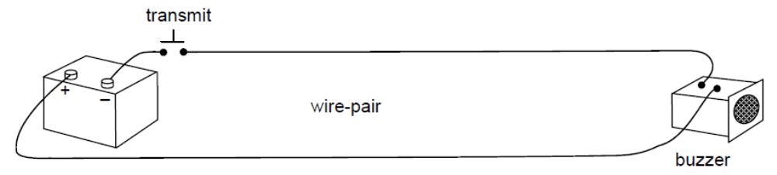
Wire-Pairs
Morse Code Transmitter
Consists of a pair of insulated copper wires
Used mainly for very short distances with low frequencies. Examples:
  Linking telephones to the nearest exchange
  Linking door bell in a house to the switch outside
High attenuation of the signal
  energy is lost as heat in the resistance of the wires
  as radiation since the wires act as aerials
Easily pick up external interference that degrades the original signal

Slide 5
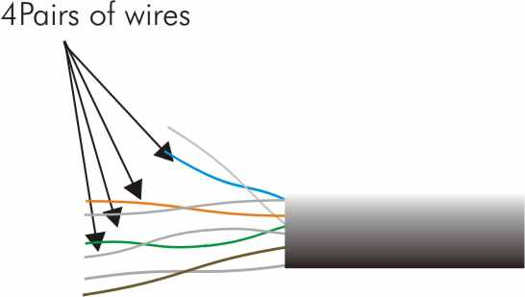
Wire-Pairs
A cable of wire-pairs
If several wire-pairs are arranged next to one another, they will pick up each other’s signals.
This effect is known as cross-talk or cross-linking and gives very poor security as it is easy to ‘tap’ a telephone conversation.
The bandwidth of a pair of wires is only about 500 kHz.
Consequently, as a means of carrying a large amount of information, it is extremely limited.

Slide 6
Coaxial Cable

Slide 7
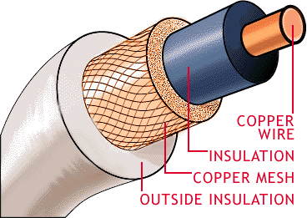
Coaxial Cable
Essentially, a pair of wires arranged so that one wire is shrouded by the other
The signal is transmitted down the inner conductor and the outer conductor acts as the return wire and also shields the inner one from external interference.
The outer conductor is usually connected to earth.

Slide 8
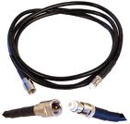
Coaxial Cable
TV cable
More expensive than wire-pairs
Less attenuation of the signal. This means that, for long distance communication, repeater amplifiers can be arranged further apart.
Less prone to external interference, though not immune to it, so they do offer slightly greater security.
The bandwidth of coaxial cable is about 50 MHz. It is capable of carrying much more information than a wire-pair.

Slide 9
Radio Link

Slide 10
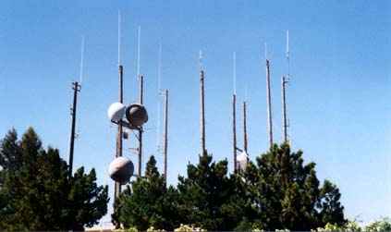
Radio Link (1)
Aerials are required for radio link.
Energy is radiated from an aerial in the form of electromagnetic waves.
These waves travel outwards from the aerial with the speed of light.
Electromagnetic waves in the frequency range 30 kHz to 3 GHz are generally referred as radio waves.

Slide 11
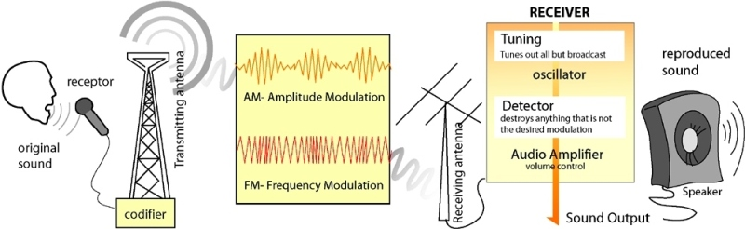
Radio Link (2)
The first radio waves used for communication were of very low frequencies and very long wavelengths. The radio waves were switched on and off so that communication was by morse code.
Later use of higher frequencies and the development of amplitude modulation (AM) enabled voice communication.
Further development, including FM broadcasts and the use of different carrier frequencies, enabled higher-quality communication and also more radio stations to operate in the same area.

Slide 12
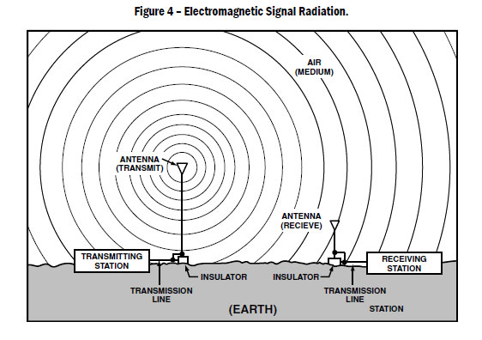
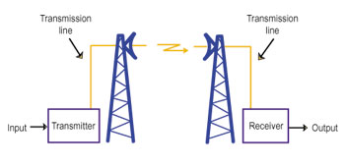
Radio Link (3)
The choice of aerial for broadcasting determines whether the radio waves are emitted
  in all directions (for broadcasting to a whole area)
  or in one direction only (for point-to-point communication).
Similarly, for the receiving of radio signals, the choice of aerial is determined by whether the signal is to be received from one direction or all directions.
Aerials with dish reflectors enable the radio waves to be transmitted as parallel beams.

Slide 13
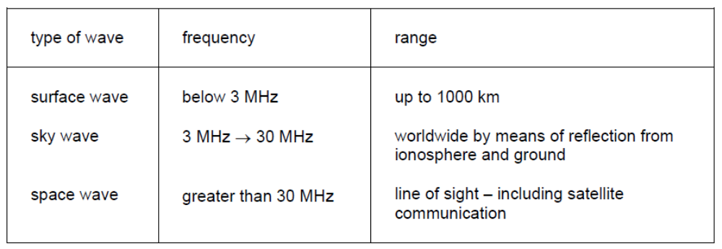
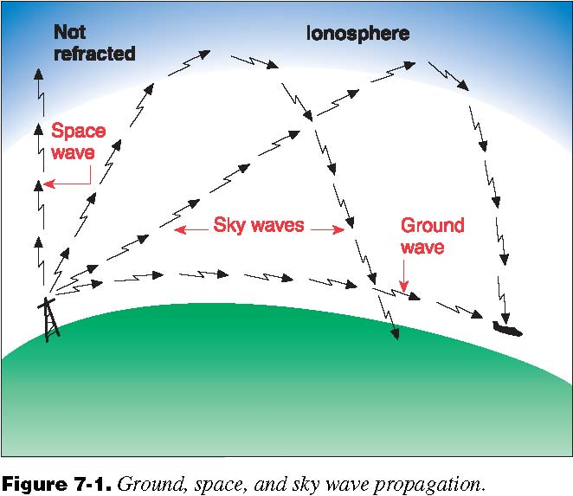
Radio Link (4)
Some Data on Frequencies and Ranges of Radio Waves
Surface waves: Waves that travel along the contour of the Earth by diffraction
Sky waves: Waves that are reflected by the ionosphere
Space waves: Waves that are transmitted in a straight line (line-of-sight, LOS) from transmitter to receiver

Slide 14
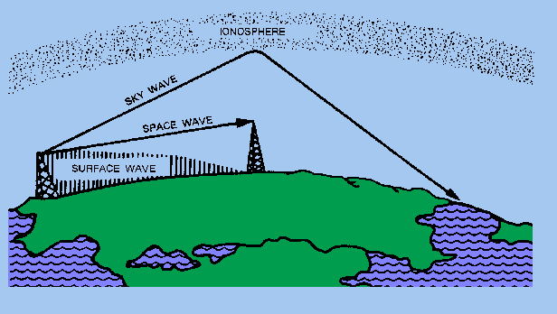
Radio Link (5)
There are two types of ground waves:
Surface waves
Space waves

Slide 15
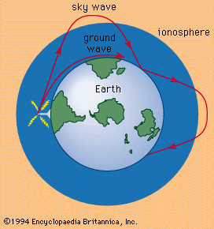
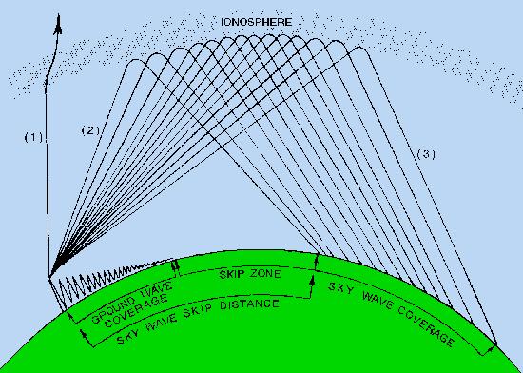
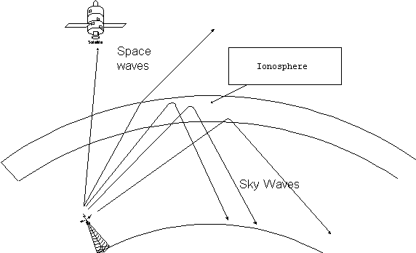
Radio Link (6)
The three types of transmitting waves complement each other.
Skip zone is an area where the waves are not received.

Slide 16
Microwave Link

Slide 17
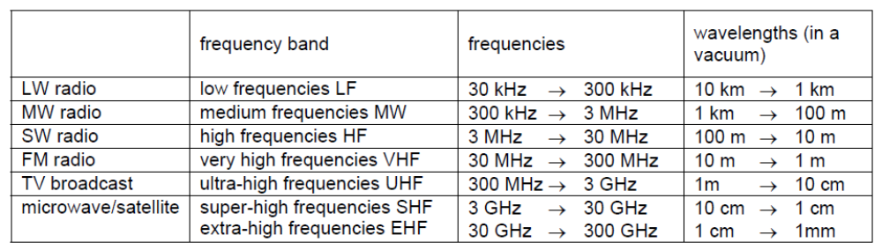
Microwave Link (1)
The Frequency Bands used for Radio Communication
Microwaves are radio waves in the SHF waveband from 3 GHz to 30 GHz.
With such high frequencies, it has very short wavelengths of only a few centimetres.
The wavelength of the radio waves determines the length of the aerial.
For mobile phones, the aerial must be, for the sake of convenience, short and hence microwaves are suitable for its use.
As the frequency of the carrier wave increases, the bandwidth also increases.

Slide 18
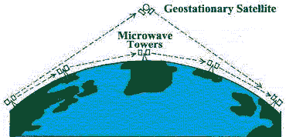
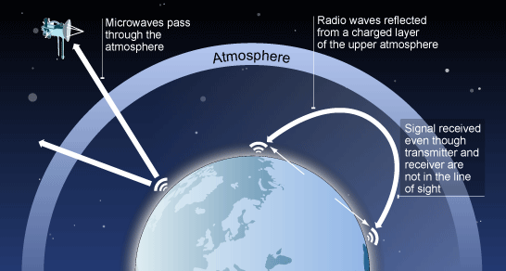
Microwave Link (2)
The bandwidth of a microwave link is of the order of GHz. This large bandwidth means that the microwave beam has a large capacity for transmitting information.
Microwaves are generally used for point-to-point communication where signals are transmitted directly from transmitter to receiver (space waves).
For terrestrial use, the range of the transmissions is limited to line-of-sight and relay stations are used.
For very long distance transmission, microwaves are transmitted beyond the atmosphere and sent back to Earth by communication satellites.

Slide 19
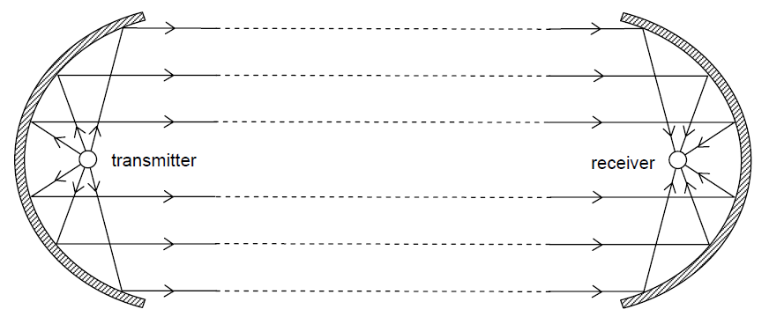
Microwave Link (3)
The transmitting element is placed at the focus of a parabolic reflector.
The parabolic reflector, reflects and focuses the wave power on to a receiving element.
In this way, the wave power is radiated in a parallel beam.
Note: The reflecting parabolic dish is not the aerial. The aerial is found at the focus of the reflecting dish.

Slide 20
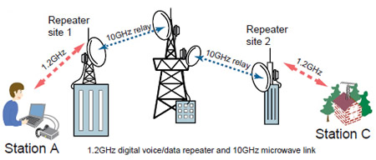
Radio Link (4)
The intensity of the waves will always be reduced (attenuated) as the distance from the transmitter increases.
They need to be strengthen / amplified at regular distance.

Slide 21
Optic Fibres

Slide 22
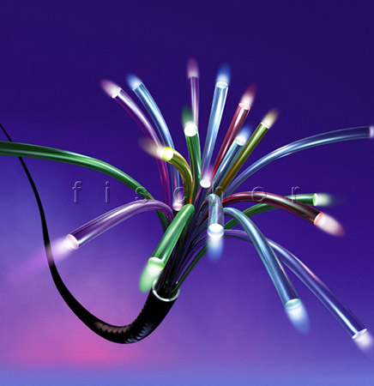
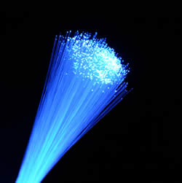
Optic Fibres
Optic fibres are strands of optically pure glass as thin as a human hair that carry digital information over long distances

Slide 23
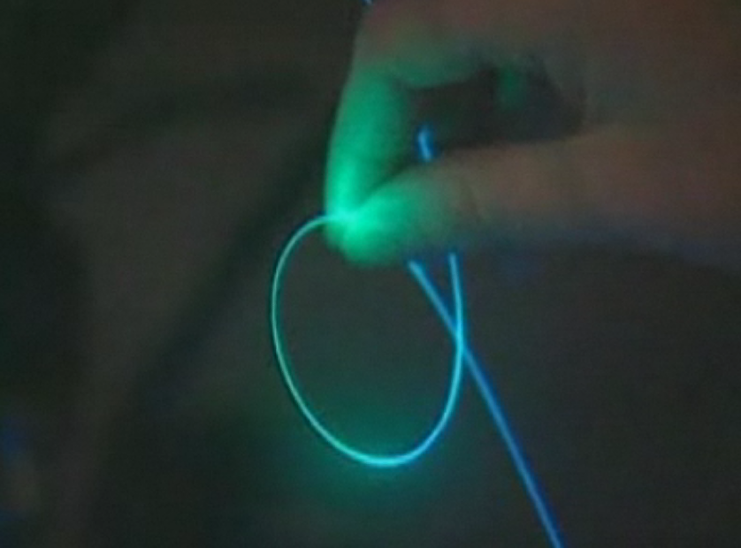
Optic Fibres
CLICK IMAGE

Slide 24
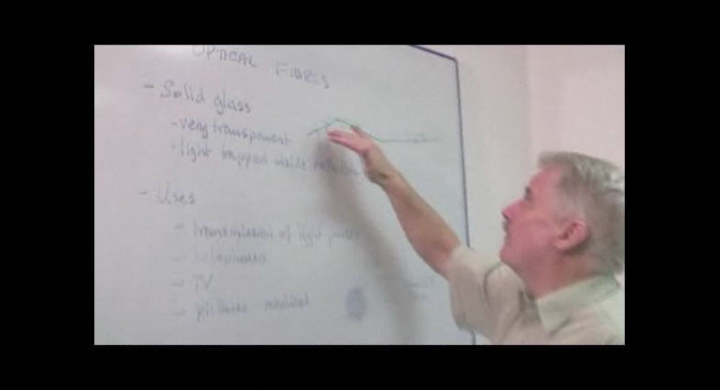
What are Optic Fibres
CLICK IMAGE
Optic fibres are solid glass.

Slide 25
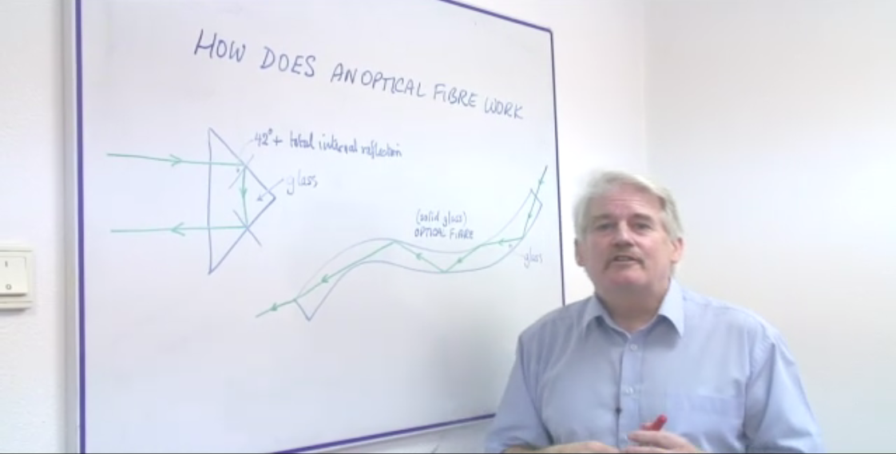
How Does Optic Fibre Work?
CLICK IMAGE
Optic fibres transmit optical pulses using the principle of total internal reflection.

Slide 26
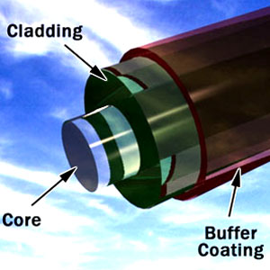
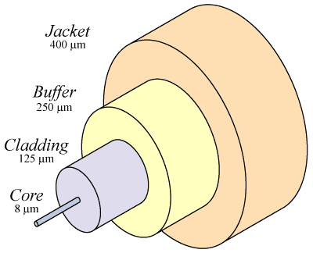
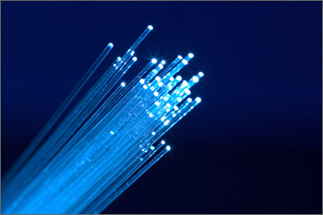
Structure of an Optic Fibre
A single optical fibre, will have the following parts:
Core - Thin glass center of the fibre where the light travels
Cladding – An outer optical material (glass of lesser density) surrounding the core
Buffer coating - Plastic coating that protects the fibre from damage and moisture
Hundreds or thousands of these optical fibres are arranged in bundles in optical cables. The bundles are protected by the cable's outer covering, called a jacket.

Slide 27
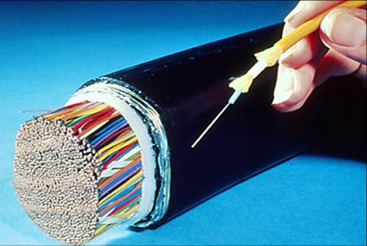
Transmitting Optical Pulses
One single optic fibre can transmitter as much data as a bundle of coaxial wires
Optic fibres carry digital information in the form of pulses of light or infra-red radiation.
These pulses are provided by lasers and the light produced has very high frequencies of the order of 10⁸ MHz.
In theory, a bit or individual light wave could last for only 10⁻¹⁴ s. This would allow hundreds of thousands of individual information, telephone calls for example, to share the same optic fibre.
However, present technology does not allow control at such high frequencies. The duration of a bit is governed by how fast the laser providing light to the fibre can be switched on and off. This is, at present, of the order of GHz but is increasing as technology develops.

Slide 28
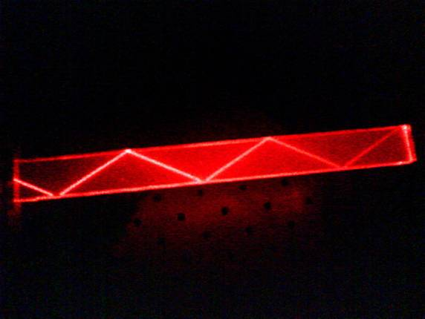
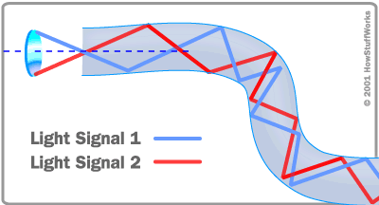
Transmitting Optical Pulses
Pulses of light or infra-red radiation travel along the fibre as a result of total internal reflection.
As there is no loss of energy in total internal reflection, the light impulses can travel great distances.
However, some of the light signal do degrade within the fibre, mostly due to impurities in the glass.

Slide 29
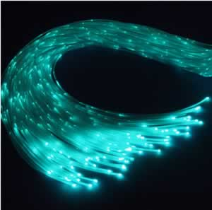
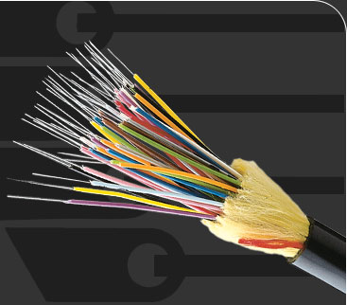
Advantages of Optic Fibres
Large bandwidth, giving rise to large transmission capacity
Much lower cost than metal wires
Diameter and weight of cable is much less than metal cable, hence easier handling and storage
Much less signal attenuation, so far fewer regenerator amplifiers are required, reducing the cost of installation
Do not pick up electromagnetic interference, so very high security and negligible cross-talk
Can be laid alongside existing routes such as electric railway lines and power lines.

Slide 30
Optic Fibre: May 2008 Q12
(a) Optic fibre transmission has, in some instances, replaced transmission using co-axial cables and wire pairs.
Optic fibres have negligible cross-talk and are less noisy than co-axial cables.
Explain what is meant by
(i) cross-talk, [2]
(ii) noise. [2]
(b) An optic fibre has a signal attenuation of 0.20 dB km–1.
The input signal to the optic fibre has a power of 26 mW. The receiver at the output of the fibre has a noise power of 6.5 μW.
Calculate the maximum uninterrupted length of optic fibre given that the signal-to-noise ratio at the receiver must not be less than 30 dB. [5]

Slide 31
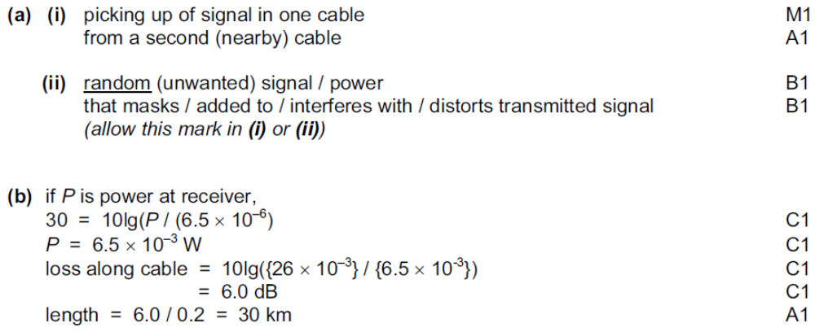
Solution: May 2008 Q12

Slide 32
Channels: Nov 2008 Q9
Different frequencies and wavelengths are used in different channels of communication.
Suggest why
(a) infra-red radiation rather than visible light is usually used with optic fibres, [2]
(b) the base stations in mobile phone networks operate on UHF, [2]
(c) for satellite communication, frequencies of the order of GHz are used, with the uplink having a different frequency to the downlink. [2]

Slide 33
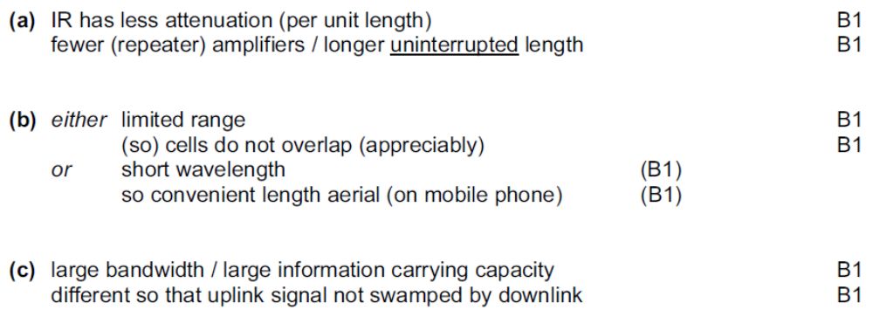
Solution: Nov 2008 Q9

